Slide 1
What movie do you want to watch next?
predicting movie success using Movie MARK®
Notes:
- We believe everyone loves movies! Or at least everyone has an opinion about which movies are the best!

Slide 2

Everyone loves movies.
Streaming has reshaped cinema and the COVID-19 pandemic has left many of us wondering “what should we watch next?”
Using data-wrangling, programming, and machine learning skills, we plan to answer:
What makes movies successful?
Notes:
- We picked movies as a topic since they have been our go-to escape from the ever-present covid topic.
- Since we know streaming services use data modeling to help us pick what to watch next, we wondered who’s using data to determine what entertainment content to make next.
- Introducing Movie MARK, a startup movie data company seeking funding.

Slide 3


Movie MARK®
Our MARK® Team
of budding Data Scientists collaborated virtually across Zoom and Slack (as “the_clever_crew”) to bring you this fine work.
Maggie Allen Presentation + GitHub + Dashboard
Andrew Malony GitHub + Graphs + Dashboard
Rose Baumann Database + Data Clean-up
Kathy Morrissey Data ETL + Machine Learning Model
predicting movie success
Notes:
- The Movie MARK team is comprised of Maggie, Andrew, Rose, and Kathy and we chose to answer the question- what makes a movie successful?

Slide 4
But first we must ask
How do we define Movie Success?
Notes:
- But first we must define movie success
- For our purposes, we consider a successful movie as one that is popular, is profitable, and perhaps even won notoriety through industry awards.

Slide 5

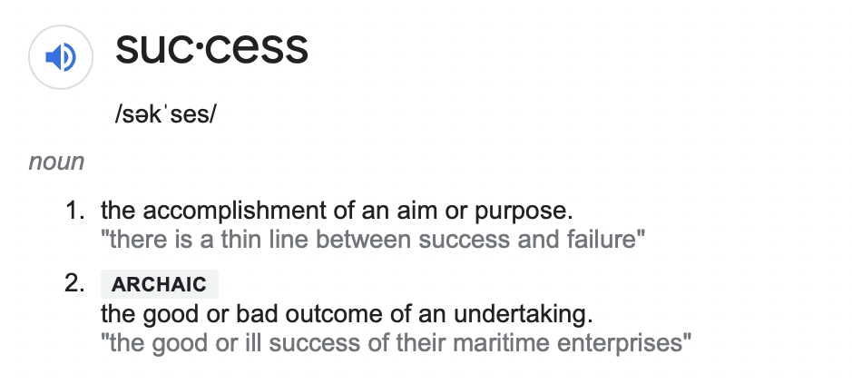
suc•cess
The Google Translate app can repeat anything you say in up to NINETY LANGUAGES from German and Japanese to Czech and Zulu
Popularity (Proprietary Scores, User Ratings, Critic Ratings)
Estimated Profitability (Revenue-Budget)
Awards
Notes:
- But first we must define movie success
- For our purposes, we consider a successful movie as one that is popular, is profitable, and perhaps even won notoriety through industry awards.

Slide 6

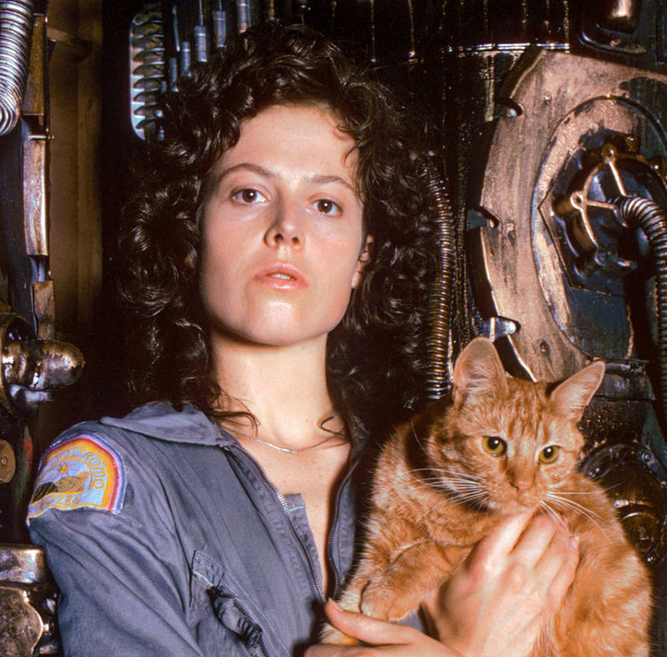
Meet Ellen.
She is the owner of a new start up streaming service, Serenity Streaming. She’s looking to use AI and Machine Learning to help connect users with their favorite movie they have never even heard of.
Right now she’s still working out of her home office and realizes despite a ton of data, she needs a proof of concept machine learning model to get investment interest.
Notes:
- Before we dive into our data, let’s meet our stakeholder/potential customers who will benefit most from our work
- Meet Ellen. Ellen is launching a streaming service and wants to make sure she’s delivering what her audiences want and maximizing her investment capital.

Slide 7

Meet Sam.
Sam is a newly promoted executive at ABC Movie Productions and is interested in determining the right mix of movie genre, Director’s talents, and A-list actors are going to be the recipe for the next blockbuster.
Before him, the boomers were sitting in rooms making all the calls but he thinks data science can flip the script.
Notes:
- Meet Sam. He got a few promotions and is now an up-and-coming movie exec ready to launch the next blockbuster hit. He thinks Movie MARK® can give his studio a competitive edge.

Slide 8
Meet Steel.
He recently had a baby so he has no time to watch a bunch of bad movies. When he finally has a free evening, he wants the first movie he streams to be one he’s happy to talk about with his new baby boy.
Let’s see what he should look for in his next popcorn night’s entertainment...
Notes:
- Last but not least, meet Steel. His lovely new bundle of joy means his time is limited.
- Being a big movie enthusiast, he wants maximize his movie watching time without wasting hours searching for what to watch next.
(

Slide 9
Spoiler Alert:
Our proof of concept was limited to analyzing ratings numeric variables.
Notes:
- Spoiler alert: our proof-of-concept machine learning model was only able to evaluate our numerical variables around ratings.
- The complexity of the data prevented us from predicting a movie’s success.
- Let’s talk about why.

Slide 10


Internet Movies DataBase (IMDb)*
The Movies DataBase (TMDB)*
Film Awards (IMDb)* (not used)
Worldwide
Movies
Directors
Our Data Exploration
Actors
Genres
1970+
Budget
MetaScore
Revenue
User Ratings
* See Appendix
Source: https://www.imdb.com
https://www.themoviedb.org/?language=en-US
https://www.kaggle.com/rounakbanik/the-movies-dataset
Critic Scores

Slide 11
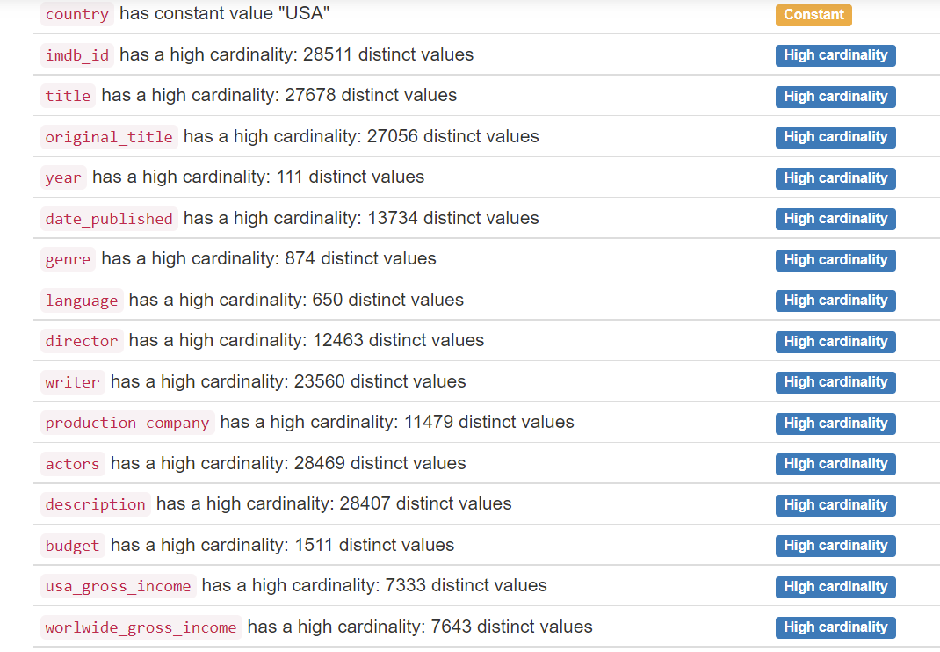
Overview of Values in Each Variable
(cardinality is a measure of set size)

Slide 12
Overview of Values in Each Variable
(cardinality is a measure of set size)
X
X
Unmanageable variety
X
X

Slide 13
Overview of Values in Each Variable
(cardinality is a measure of set size)
X
X
X
X
X
X
Low veracity (reliability)
X

Slide 14
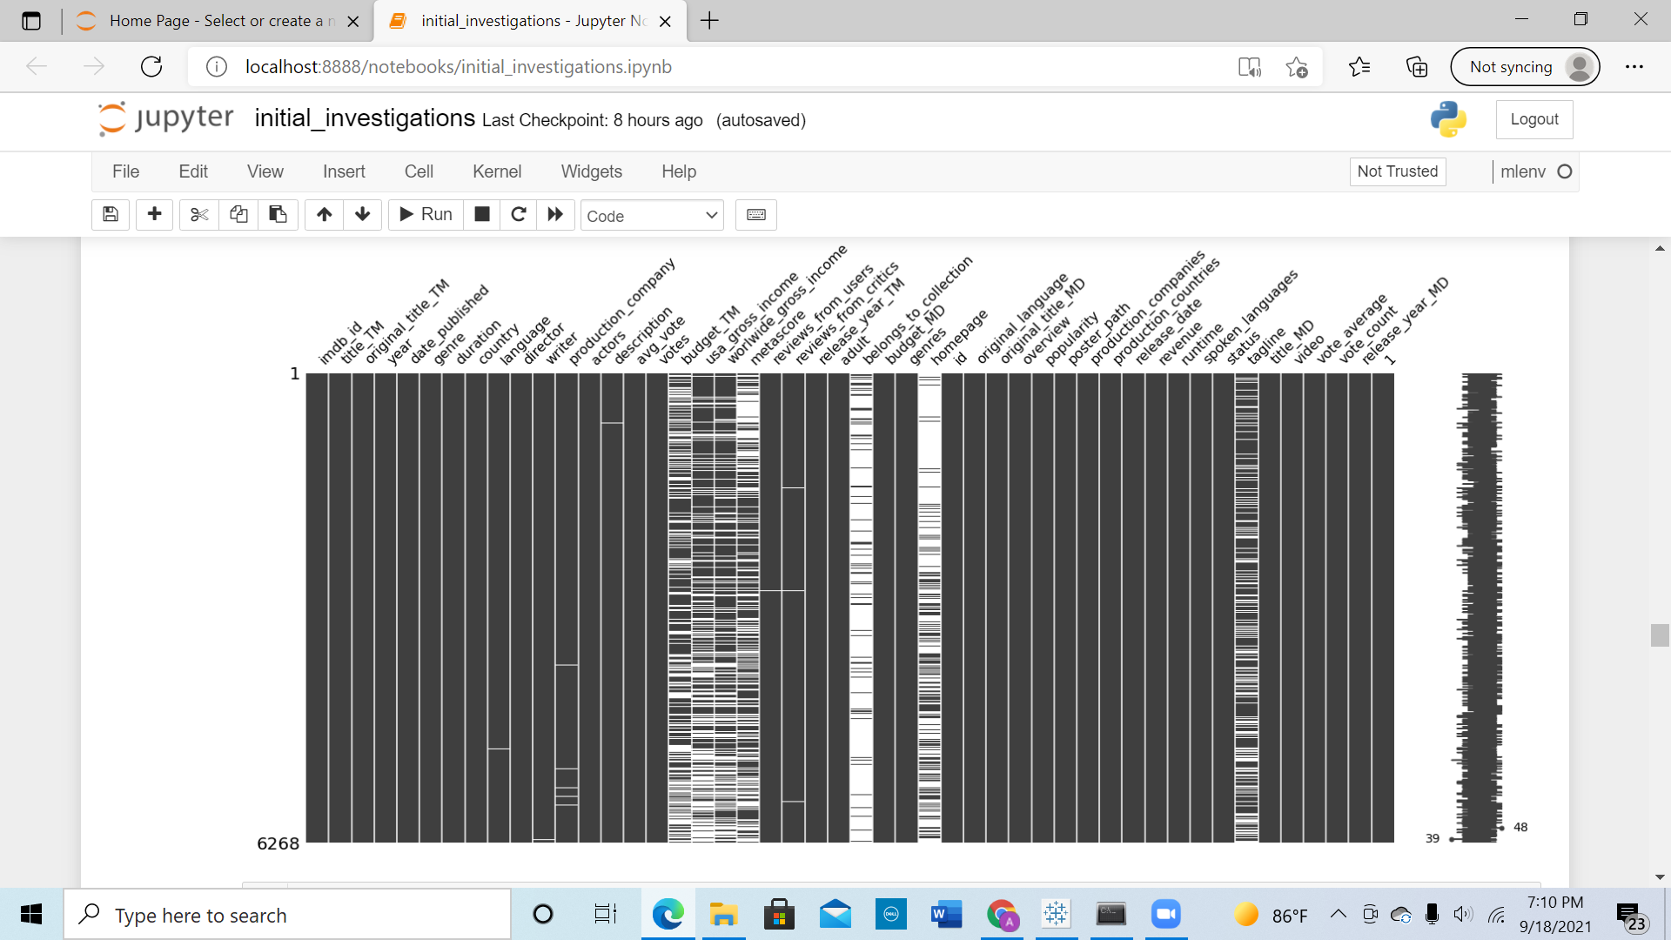
Add slide with missing data
Missing Data

Slide 15

2M+ data entries
70.5k rows of data
filter
drop na
Our data was filtered, cleaned, and joined to remove missing data, filter by relevant content, and categorical variables were converted for machine learning data modeling.
remove
convert
model data
3 Total Variables Remaining

Slide 16
Technologies
Data Storage: PostgreSQL database 13.3 hosted on Amazon Web Services
* See Appendix

Slide 17
Technologies
Data Cleaning + Analysis: Python 3.8.5, Pandas Library 1.3.2 (and dozens more*) in Jupyter Notebook 6.1.4
Data Storage: PostgreSQL database 13.3 hosted on Amazon Web Services
Machine Learning: Scikit-Learn 0.24 (+ dozens of additional Python libraries*) in Jupyter Notebook 6.1.4
Dashboard: matplotlib 3.4.3 using Jupyter Notebook 6.1.4 + Tableau 2021.2.2
* See Appendix
Notes:
o Real quick recap of other tech we used.
o Jupyter Notebooks, obviously significant.
o Call out: ProfileReport dependency.
o Data hosted in a PostgreSQL on AWS.
o Chose Tableau for versatility/plug ‘n play.

Slide 18
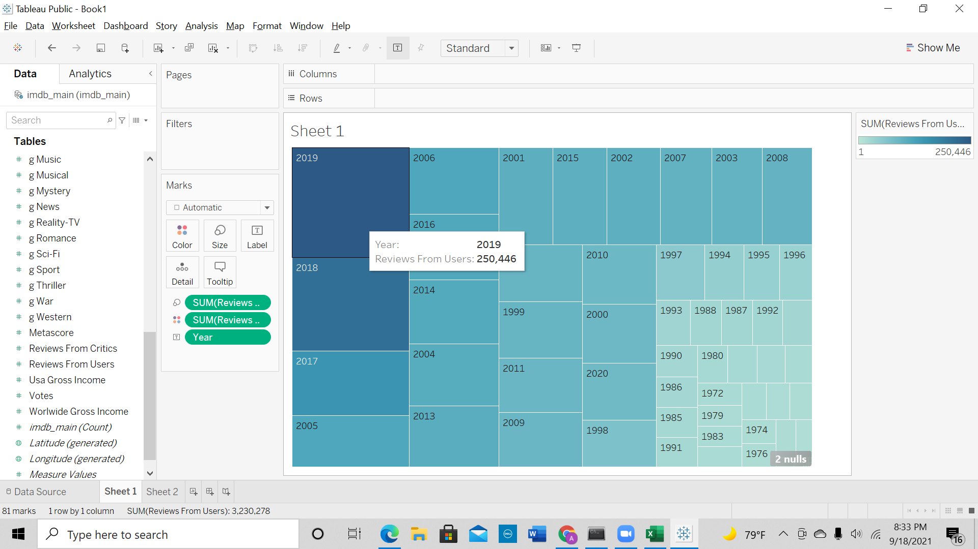
Notes:
o We had priors about what could predict movie success. And a few of those features jumped out at us when we began poking around the raw and clean versions of the data.
o For instance, there seemed to be a fairly clear relationship between release year/engagement with a film, as depicted by the number of user reviews (internet, recency bias, expansion of IMDb/TMDB datasets? All plausible contributors)

Slide 19
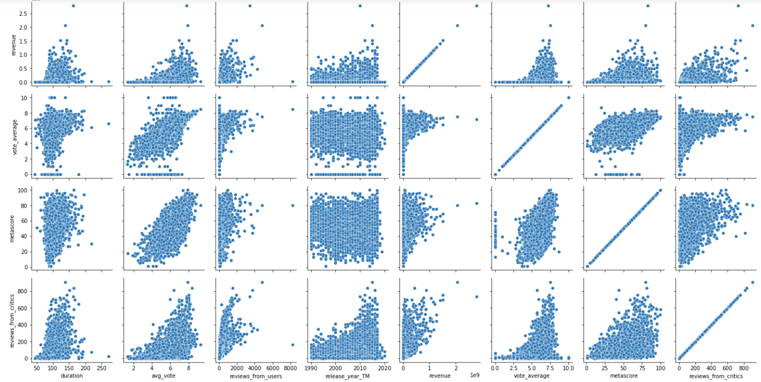
Average IMDb Score vs. Average TMDB Score has a Positive Correlation
Relationships of Numerical Variables in Movies Data
Notes:
o Another one – average IMDb scores and TMDB scores of films. These are weighted user scores of each film. That IMDb average also seemed to correspond with Metascore, a measure generated by critics’ input (similar lines as RT?)

Slide 20
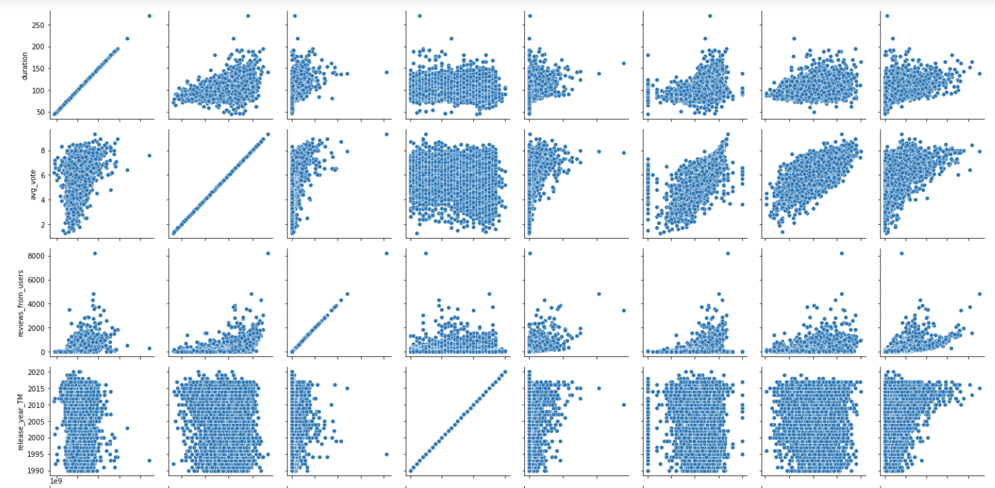
Average IMDb Score vs. Critic MetaScore has a Positive Correlation
Relationships of Numerical Variables in Movies Data
Notes:
Correlation coefficient between average user vote and metascore is 0.67

Slide 21
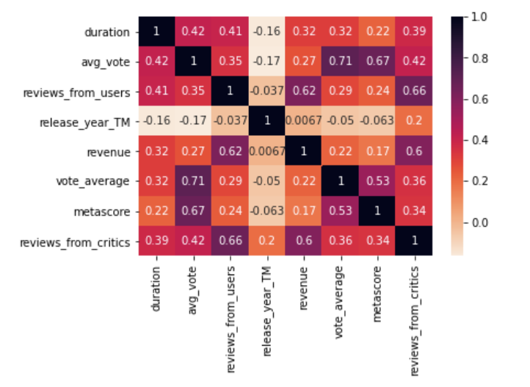
CONCLUSION:
Some positive correlation between revenue and user reviews
Duration and Release Year has minimal correlations to other variables
Note: Dropping revenue variable because data is incomplete
Correlations in Numeric Variables (Confusion Matrix)
Notes:
o Similar story told by correlation matrix.
o Not all of our variables were represented here, and you already know we didn’t end up keeping many of them.
o But perhaps just as interesting as positive correlations were weak/negative correlations.
o Release year – more engagement, more negativity with more new projects?
o Fewer high-quality projects?
o Nostalgia for old movies?
- *You can get a more granular feel for some of the data in our dashboard. 1st viz – average vote by duration/worldwide box office numbers.
o Spider-Man search: -- differing opinions, similar stratosphere at the box (dedicated fans of the franchise?)
o Fast & Furious (type: furious) – nice correspondence between well-liked/willingness to pay to see. Word-of-mouth factor?
o Both franchises: similar duration/runtime – with some exceptions, around the 120-130 sweet-spot

Slide 22
Some Data Issues
We Encountered
Our Data Transformation
Datasets were not well documented
Scraped raw data inconsistencies
Missing data in “success” variables
Lots of categorical data
Strings of data in JSON-like format
Proprietary or outdated data
Currency symbols created strings
Mismatched data types in columns
Multiple unique entries per cell
… and more.
Notes:
Some common issues in cleaning the data had to be overcome, including:
Strings of data that appeared to be in json format were not and had to be processed through string evaluation to extract the contents
Mixed data types within a data element that had to be identified and properly converted to the same data type
Currency abbreviations attached to numbers that casued the inferred data types to be rendered as strings
Raw data scraped from websites is generally prone to inconsistency in data structures, inconsistency in data encoding and data entry errors. This variability in data elements places great importance on discerning the actual meaning of values, matching strings to identify dictinct categories, and devising appropriate transformations for use in machine learning models
The datasets were cleaned separ

Slide 23
Machine
Learning
Model
The ratings dataset contains:
vote average (1-10)
number of votes from IMDB users
number of reviews from critics
profits
ratings
awards
Our Objective: Predict if a movie will be successful or not.
Notes:
this is not an unweighted average across all IMDB users. This is a weighted average based on an undisclosed IMDB propietary algorithm. Scores range from 1 to 10.

Slide 24
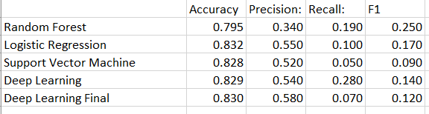
Model Comparison
 | Accuracy | Precision | Recall | F1
Random Forest | 0.803 | 0.390 | 0.240 | 0.290
Logistic Regression | 0.830 | 0.570 | 0.090 | 0.150
Support Vector Machine | 0.831 | 0.619 | 0.070 | 0.150
Deep Learning | 0.831 | 0.580 | 0.090 | 0.150
Deep Learning Final | 0.832 | 0.580 | 0.100 | 0.150
profits
ratings
awards
Our Objective: Predict if a movie will be successful or not.

Slide 25
Model Comparison
 | Accuracy | Precision | Recall | F1
Random Forest | 0.803 | 0.390 | 0.240 | 0.290
Logistic Regression | 0.830 | 0.570 | 0.090 | 0.150
Support Vector Machine | 0.831 | 0.619 | 0.070 | 0.150
Deep Learning | 0.831 | 0.580 | 0.090 | 0.150
Deep Learning Final | 0.832 | 0.580 | 0.100 | 0.150
profits
ratings
awards
Our Objective: Predict if a movie will be successful or not.

Slide 26
Model Comparison
 | Accuracy | Precision | Recall | F1
Random Forest | 0.803 | 0.390 | 0.240 | 0.290
Logistic Regression | 0.830 | 0.570 | 0.090 | 0.150
Support Vector Machine | 0.831 | 0.619 | 0.070 | 0.150
Deep Learning | 0.831 | 0.580 | 0.090 | 0.150
Deep Learning Final | 0.832 | 0.580 | 0.100 | 0.150
profits
ratings
awards
Our Objective: Predict if a movie will be successful or not.

Slide 27
Model Comparison
 | Accuracy | Precision | Recall | F1
Random Forest | 0.803 | 0.390 | 0.240 | 0.290
Logistic Regression | 0.830 | 0.570 | 0.090 | 0.150
Support Vector Machine | 0.831 | 0.619 | 0.070 | 0.150
Deep Learning | 0.831 | 0.580 | 0.090 | 0.150
Deep Learning Final | 0.832 | 0.580 | 0.100 | 0.150
profits
ratings
awards
Our Objective: Predict if a movie will be successful or not.

Slide 28
Model Comparison
 | Accuracy | Precision | Recall | F1
Random Forest | 0.803 | 0.390 | 0.240 | 0.290
Logistic Regression | 0.830 | 0.570 | 0.090 | 0.150
Support Vector Machine | 0.831 | 0.619 | 0.070 | 0.150
Deep Learning | 0.831 | 0.580 | 0.090 | 0.150
Deep Learning Final | 0.832 | 0.580 | 0.100 | 0.150
profits
ratings
awards
Our Objective: Predict if a movie will be successful or not.

Slide 29
Model Comparison
 | Accuracy | Precision | Recall | F1
Random Forest | 0.803 | 0.390 | 0.240 | 0.290
Logistic Regression | 0.830 | 0.570 | 0.090 | 0.150
Support Vector Machine | 0.831 | 0.619 | 0.070 | 0.150
Deep Learning | 0.831 | 0.580 | 0.090 | 0.150
Deep Learning Final | 0.832 | 0.580 | 0.100 | 0.150
profits
ratings
awards
Our Objective: Predict if a movie will be successful or not.

Slide 30
Model Comparison
 | Accuracy | Precision | Recall | F1
Random Forest | 0.803 | 0.390 | 0.240 | 0.290
Logistic Regression | 0.830 | 0.570 | 0.090 | 0.150
Support Vector Machine | 0.831 | 0.619 | 0.070 | 0.150
Deep Learning | 0.831 | 0.580 | 0.090 | 0.150
Deep Learning Final | 0.832 | 0.580 | 0.100 | 0.150
profits
ratings
awards
Our Objective: Predict if a movie will be successful or not.

Slide 31
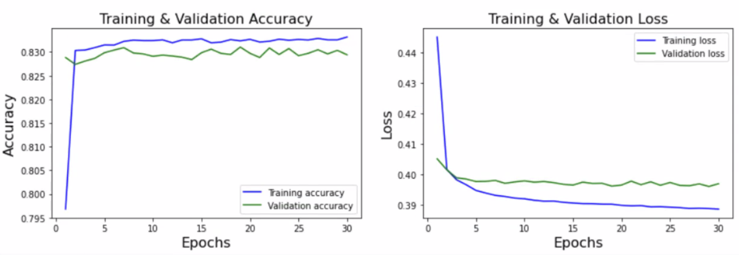
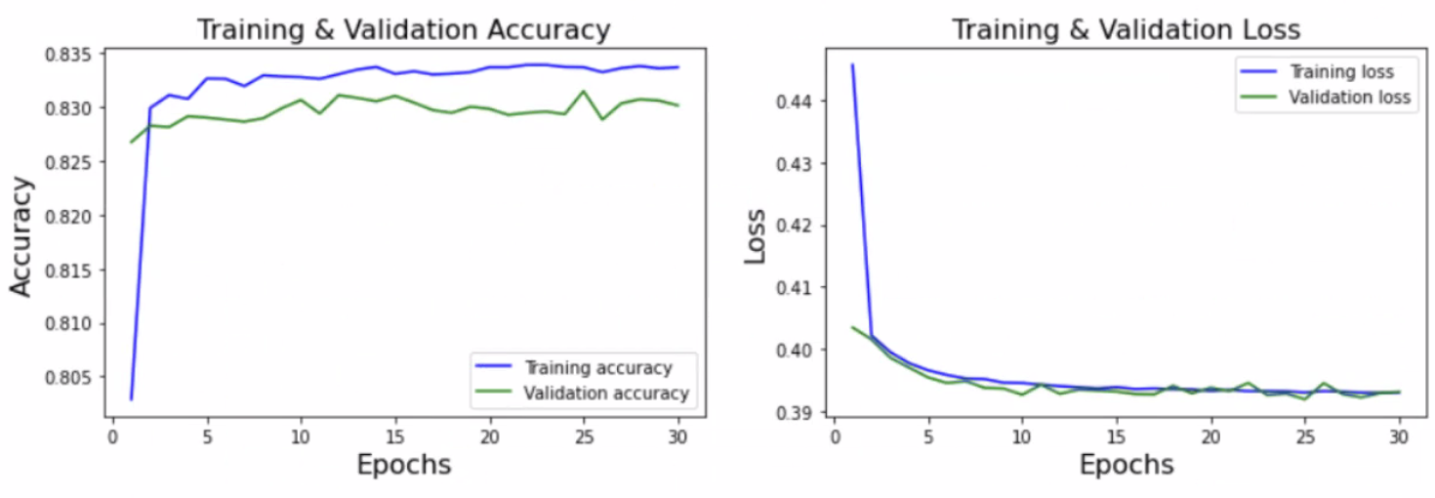
random seed 67
random seed 189

Slide 32
The plot thickens...
Having a ton of data doesn’t necessarily mean it is useful.

Slide 33
Where do we go from here?
Seek Out Additional Data Sources (Awards, A-list, Rotten Tomato, etc.)
Deep Dive Categorical Variables
Natural Language Processing of Reviews
Machine Learning Models for Predicting Future Success
Plot Twist?
What would we do differently? Maybe clone our team members to get after all the things left on the table!*
* We would definitely clone Kathy twice

Slide 34

:(

Slide 35
:(
:(

Slide 36
:(
:(
:)
Is it a coincidence that our instructor is the only happy camper in the bunch? Maybe...

Slide 37

Fin

Slide 38
Appendix
ENCORE

Slide 39
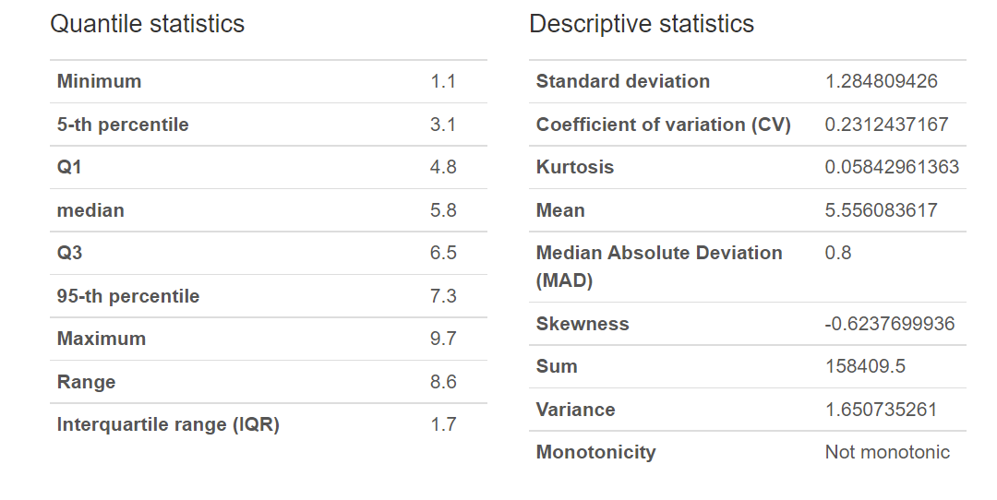
Average IMDb Score Summary Statistics

Slide 40
LIBRARIES AND TECHNOLOGIES LOADED ON OUR LOCAL MACHINE TO COMPLETE ETL
$ pip freeze
absl-py @ file:///C:/ci/absl-py_1623867338309/work
alabaster==0.7.12
anaconda-client==1.7.2
anaconda-project @ file:///tmp/build/80754af9/anaconda-project_1610472525955/work
anyio @ file:///C:/ci/anyio_1620153167783/work/dist
appdirs==1.4.4
argh==0.26.2
argon2-cffi @ file:///C:/ci/argon2-cffi_1613038019788/work
asn1crypto @ file:///tmp/build/80754af9/asn1crypto_1596577642040/work
astor==0.8.1
astroid @ file:///C:/ci/astroid_1613500971479/work
astropy @ file:///C:/ci/astropy_1617745665646/work
astunparse==1.6.3
async-generator==1.10
atomicwrites==1.4.0
attrs @ file:///tmp/build/80754af9/attrs_1604765588209/work
autopep8 @ file:///tmp/build/80754af9/autopep8_1615918855173/work
Babel @ file:///tmp/build/80754af9/babel_1607110387436/work
backcall==0.2.0
backports.shutil-get-terminal-size @ file:///tmp/build/80754af9/backports.shutil_get_terminal_size_1608222128777/work
bcrypt @ file:///C:/ci/bcrypt_1597918112552/work
beautifulsoup4 @ file:///home/linux1/recipes/ci/beautifulsoup4_1610988766420/work
bitarray @ file:///C:/ci/bitarray_1618435050316/work
bkcharts==0.2
black==19.10b0
bleach @ file:///tmp/build/80754af9/bleach_1612211392645/work
blinker==1.4
bokeh @ file:///C:/ci/bokeh_1620784051578/work
boto==2.49.0
Bottleneck==1.3.2
brotlipy==0.7.0
cachetools @ file:///tmp/build/80754af9/cachetools_1619597386817/work
certifi==2020.12.5
cffi @ file:///C:/ci/cffi_1613247308275/work
chardet @ file:///C:/ci/chardet_1607706910910/work
click @ file:///home/linux1/recipes/ci/click_1610990599742/work
cloudpickle @ file:///tmp/build/80754af9/cloudpickle_1598884132938/work
clyent==1.2.2
colorama==0.4.4
comtypes==1.1.9
contextlib2==0.6.0.post1
coverage @ file:///C:/ci/coverage_1614614910274/work
cryptography @ file:///C:/ci/cryptography_1616769432139/work
cycler==0.10.0
Cython @ file:///C:/ci/cython_1618435342622/work
cytoolz==0.11.0
dask @ file:///tmp/build/80754af9/dask-core_1617390489108/work
decorator==5.0.7
defusedxml @ file:///tmp/build/80754af9/defusedxml_1615228127516/work
diff-match-patch @ file:///tmp/build/80754af9/diff-match-patch_1594828741838/work
distributed @ file:///C:/ci/distributed_1617384292700/work
docutils @ file:///C:/ci/docutils_1617481620173/work
entrypoints==0.3
et-xmlfile==1.0.1
fastcache==1.1.0
filelock @ file:///home/linux1/recipes/ci/filelock_1610993975404/work
flake8 @ file:///tmp/build/80754af9/flake8_1615834841867/work
Flask @ file:///home/ktietz/src/ci/flask_1611932660458/work
fsspec @ file:///tmp/build/80754af9/fsspec_1617959894824/work
future==0.18.2
gast==0.3.3
gevent @ file:///C:/ci/gevent_1616773028237/work
glob2 @ file:///home/linux1/recipes/ci/glob2_1610991677669/work
google-auth @ file:///tmp/build/80754af9/google-auth_1600960338579/work
google-auth-oauthlib @ file:///tmp/build/80754af9/google-auth-oauthlib_1617120569401/work
google-pasta==0.2.0
greenlet @ file:///C:/ci/greenlet_1611958376725/work
grpcio @ file:///C:/ci/grpcio_1614884419385/work
h5py==2.10.0
HeapDict==1.0.1
html5lib @ file:///tmp/build/80754af9/html5lib_1593446221756/work
idna @ file:///home/linux1/recipes/ci/idna_1610986105248/work
imagecodecs @ file:///C:/ci/imagecodecs_1617996781001/work
imageio @ file:///tmp/build/80754af9/imageio_1617700267927/work
imagesize @ file:///Users/ktietz/demo/mc3/conda-bld/imagesize_1628863108022/work
imbalanced-learn @ file:///home/conda/feedstock_root/build_artifacts/imbalanced-learn_1613662486985/work
importlib-metadata @ file:///C:/ci/importlib-metadata_1617877486026/work
iniconfig @ file:///home/linux1/recipes/ci/iniconfig_1610983019677/work
intervaltree @ file:///tmp/build/80754af9/intervaltree_1598376443606/work
ipykernel==5.5.3
ipython==7.23.0
ipython-genutils==0.2.0
ipywidgets @ file:///tmp/build/80754af9/ipywidgets_1610481889018/work
isort @ file:///tmp/build/80754af9/isort_1616355431277/work
itsdangerous==1.1.0
jdcal==1.4.1
jedi==0.18.0
Jinja2 @ file:///tmp/build/80754af9/jinja2_1612213139570/work
joblib @ file:///tmp/build/80754af9/joblib_1613502643832/work
json5==0.9.5
jsonschema @ file:///tmp/build/80754af9/jsonschema_1602607155483/work
jupyter==1.0.0
jupyter-client==6.1.12
jupyter-console @ file:///tmp/build/80754af9/jupyter_console_1616615302928/work
jupyter-contrib-core==0.3.3
jupyter-core==4.7.1
jupyter-nbextensions-configurator @ file:///D:/bld/jupyter_nbextensions_configurator_1611341300533/work
jupyter-packaging @ file:///tmp/build/80754af9/jupyter-packaging_1613502826984/work
jupyter-server @ file:///C:/ci/jupyter_server_1616084265530/work
jupyterlab @ file:///tmp/build/80754af9/jupyterlab_1619133235951/work
jupyterlab-pygments @ file:///tmp/build/80754af9/jupyterlab_pygments_1601490720602/work
jupyterlab-server @ file:///tmp/build/80754af9/jupyterlab_server_1617134334258/work
jupyterlab-widgets @ file:///tmp/build/80754af9/jupyterlab_widgets_1609884341231/work
Keras @ file:///tmp/build/80754af9/keras_split_1593112142734/work
Keras-Applications @ file:///tmp/build/80754af9/keras-applications_1594366238411/work
Keras-Preprocessing @ file:///tmp/build/80754af9/keras-preprocessing_1612283640596/work
keyring @ file:///C:/ci/keyring_1614630298708/work
kiwisolver @ file:///C:/ci/kiwisolver_1612282618948/work
lazy-object-proxy @ file:///C:/ci/lazy-object-proxy_1616529290879/work
libarchive-c @ file:///tmp/build/80754af9/python-libarchive-c_1617780486945/work
llvmlite==0.36.0
locket==0.2.1
lxml @ file:///C:/ci/lxml_1616443391272/work
Markdown @ file:///C:/ci/markdown_1614364005059/work
MarkupSafe @ file:///C:/ci/markupsafe_1594405949945/work
matplotlib @ file:///C:/ci/matplotlib-suite_1613408055530/work
matplotlib-inline==0.1.2
mccabe==0.6.1
menuinst==1.4.16
mistune @ file:///C:/ci/mistune_1594373272338/work
mkl-fft==1.3.0
mkl-random @ file:///C:/ci/mkl_random_1618854593605/work
mkl-service==2.3.0
mock @ file:///tmp/build/80754af9/mock_1607622725907/work
more-itertools @ file:///tmp/build/80754af9/more-itertools_1613676688952/work
mpmath==1.2.1
msgpack @ file:///C:/ci/msgpack-python_1612287191162/work
multipledispatch==0.6.0
mypy-extensions==0.4.3
nbclassic @ file:///tmp/build/80754af9/nbclassic_1616085367084/work
nbclient @ file:///tmp/build/80754af9/nbclient_1614364831625/work
nbconvert @ file:///C:/ci/nbconvert_1601914921407/work
nbformat @ file:///tmp/build/80754af9/nbformat_1617383369282/work
nest-asyncio @ file:///tmp/build/80754af9/nest-asyncio_1613680548246/work
networkx @ file:///tmp/build/80754af9/networkx_1598376031484/work
nltk @ file:///tmp/build/80754af9/nltk_1618327084230/work
nose @ file:///tmp/build/80754af9/nose_1606773131901/work
notebook @ file:///C:/ci/notebook_1616443616158/work
numba @ file:///C:/ci/numba_1616774290339/work
numexpr @ file:///C:/ci/numexpr_1618856761305/work
numpy @ file:///C:/ci/numpy_and_numpy_base_1618497408168/work
numpydoc @ file:///tmp/build/80754af9/numpydoc_1605117425582/work
oauthlib @ file:///tmp/build/80754af9/oauthlib_1623060228408/work
olefile==0.46
openpyxl @ file:///tmp/build/80754af9/openpyxl_1615411699337/work
opt-einsum @ file:///tmp/build/80754af9/opt_einsum_1621500238896/work
packaging @ file:///tmp/build/80754af9/packaging_1611952188834/work
pandas @ file:///C:/ci/pandas_1618365631664/work
pandocfilters @ file:///C:/ci/pandocfilters_1605102427207/work
paramiko @ file:///tmp/build/80754af9/paramiko_1598886428689/work
parso==0.8.2
partd @ file:///tmp/build/80754af9/partd_1618000087440/work
path @ file:///C:/ci/path_1614022434895/work
pathlib2 @ file:///C:/ci/pathlib2_1607025068091/work
pathspec==0.7.0
patsy==0.5.1
pep8==1.7.1
pexpect @ file:///tmp/build/80754af9/pexpect_1605563209008/work
pickleshare==0.7.5
Pillow @ file:///C:/ci/pillow_1617386319301/work
pkginfo==1.7.0
pluggy @ file:///C:/ci/pluggy_1615976530170/work
ply==3.11
prometheus-client @ file:///tmp/build/80754af9/prometheus_client_1618088486455/work
prompt-toolkit==3.0.18
protobuf==3.17.2
psutil @ file:///C:/ci/psutil_1612298033174/work
psycopg2 @ file:///C:/ci/psycopg2_1612298715048/work
ptyprocess @ file:///tmp/build/80754af9/ptyprocess_1609355006118/work/dist/ptyprocess-0.7.0-py2.py3-none-any.whl
py @ file:///tmp/build/80754af9/py_1607971587848/work
pyasn1==0.4.8
pyasn1-modules==0.2.8
pycodestyle @ file:///home/ktietz/src/ci_mi/pycodestyle_1612807597675/work
pycosat==0.6.3
pycparser @ file:///tmp/build/80754af9/pycparser_1594388511720/work
pycrypto==2.6.1
pycurl==7.43.0.6
pydocstyle @ file:///tmp/build/80754af9/pydocstyle_1616182067796/work
pyerfa @ file:///C:/ci/pyerfa_1619391058121/work
pyflakes @ file:///home/ktietz/src/ci_ipy2/pyflakes_1612551159640/work
Pygments==2.8.1
PyJWT @ file:///C:/ci/pyjwt_1619651810943/work
pylint @ file:///C:/ci/pylint_1617135975189/work
pyls-black @ file:///tmp/build/80754af9/pyls-black_1607553132291/work
pyls-spyder @ file:///tmp/build/80754af9/pyls-spyder_1613849700860/work
PyNaCl @ file:///C:/ci/pynacl_1595009241355/work
pyodbc===4.0.0-unsupported
pyOpenSSL @ file:///tmp/build/80754af9/pyopenssl_1608057966937/work
pyparsing @ file:///home/linux1/recipes/ci/pyparsing_1610983426697/work
pyreadline==2.1
pyrsistent @ file:///C:/ci/pyrsistent_1600123688363/work
PySocks @ file:///C:/ci/pysocks_1594394709107/work
pytest==6.2.3
python-dateutil==2.8.1
python-jsonrpc-server @ file:///tmp/build/80754af9/python-jsonrpc-server_1600278539111/work
python-language-server @ file:///tmp/build/80754af9/python-language-server_1607972495879/work
pytz @ file:///tmp/build/80754af9/pytz_1612215392582/work
PyWavelets @ file:///C:/ci/pywavelets_1601658407053/work
pywin32==300
pywin32-ctypes @ file:///C:/ci/pywin32-ctypes_1594392691209/work
pywinpty==0.5.7
PyYAML==5.4.1
pyzmq==22.0.3
QDarkStyle==2.8.1
QtAwesome @ file:///tmp/build/80754af9/qtawesome_1615991616277/work
qtconsole @ file:///tmp/build/80754af9/qtconsole_1616775094278/work
QtPy==1.9.0
regex @ file:///C:/ci/regex_1617569892025/work
requests @ file:///tmp/build/80754af9/requests_1608241421344/work
requests-oauthlib==1.3.0
rope @ file:///tmp/build/80754af9/rope_1602264064449/work
rsa @ file:///tmp/build/80754af9/rsa_1614366226499/work
Rtree @ file:///C:/ci/rtree_1618421019532/work
ruamel-yaml-conda @ file:///C:/ci/ruamel_yaml_1616016865685/work
scikit-image==0.18.1
scikit-learn @ file:///C:/ci/scikit-learn_1614446716349/work
scipy @ file:///C:/ci/scipy_1618856134946/work
seaborn @ file:///tmp/build/80754af9/seaborn_1608578541026/work
Send2Trash @ file:///tmp/build/80754af9/send2trash_1607525499227/work
simplegeneric==0.8.1
singledispatch @ file:///tmp/build/80754af9/singledispatch_1614366001199/work
six==1.15.0
sniffio @ file:///C:/ci/sniffio_1614030522573/work
snowballstemmer @ file:///tmp/build/80754af9/snowballstemmer_1611258885636/work
sortedcollections @ file:///tmp/build/80754af9/sortedcollections_1611172717284/work
sortedcontainers @ file:///tmp/build/80754af9/sortedcontainers_1606865132123/work
soupsieve @ file:///tmp/build/80754af9/soupsieve_1616183228191/work
Sphinx @ file:///tmp/build/80754af9/sphinx_1620777493457/work
sphinxcontrib-applehelp @ file:///home/ktietz/src/ci/sphinxcontrib-applehelp_1611920841464/work
sphinxcontrib-devhelp @ file:///home/ktietz/src/ci/sphinxcontrib-devhelp_1611920923094/work
sphinxcontrib-htmlhelp @ file:///home/ktietz/src/ci/sphinxcontrib-htmlhelp_1611920974801/work
sphinxcontrib-jsmath @ file:///home/ktietz/src/ci/sphinxcontrib-jsmath_1611920942228/work
sphinxcontrib-qthelp @ file:///home/ktietz/src/ci/sphinxcontrib-qthelp_1611921055322/work
sphinxcontrib-serializinghtml @ file:///home/ktietz/src/ci/sphinxcontrib-serializinghtml_1611920755253/work
sphinxcontrib-websupport @ file:///tmp/build/80754af9/sphinxcontrib-websupport_1597081412696/work
spyder @ file:///C:/ci/spyder_1616776686228/work
spyder-kernels @ file:///C:/ci/spyder-kernels_1614030834721/work
SQLAlchemy @ file:///C:/ci/sqlalchemy_1618090063585/work
statsmodels==0.12.2
sympy @ file:///C:/ci/sympy_1618255481827/work
tables==3.6.1
tblib @ file:///tmp/build/80754af9/tblib_1597928476713/work
tensorboard @ file:///home/builder/ktietz/aggregate/tensorflow_recipes/ci_te/tensorboard_1614593728657/work/tmp_pip_dir
tensorboard-plugin-wit==1.6.0
tensorflow==2.3.0
tensorflow-estimator @ file:///home/builder/ktietz/aggregate/tensorflow_recipes/ci_baze37/tensorflow-estimator_1622026529081/work/tensorflow_estimator-2.5.0-py2.py3-none-any.whl
termcolor==1.1.0
terminado==0.9.4
testpath @ file:///home/ktietz/src/ci/testpath_1611930608132/work
textdistance @ file:///tmp/build/80754af9/textdistance_1612461398012/work
threadpoolctl @ file:///tmp/tmp9twdgx9k/threadpoolctl-2.1.0-py3-none-any.whl
three-merge @ file:///tmp/build/80754af9/three-merge_1607553261110/work
tifffile @ file:///tmp/build/80754af9/tifffile_1619636090847/work
toml @ file:///tmp/build/80754af9/toml_1616166611790/work
toolz @ file:///home/linux1/recipes/ci/toolz_1610987900194/work
tornado==6.1
tqdm @ file:///tmp/build/80754af9/tqdm_1615925068909/work
traitlets==5.0.5
typed-ast @ file:///C:/ci/typed-ast_1610484654578/work
typing-extensions @ file:///home/ktietz/src/ci_mi/typing_extensions_1612808209620/work
ujson @ file:///C:/ci/ujson_1611244941645/work
unicodecsv==0.14.1
urllib3 @ file:///tmp/build/80754af9/urllib3_1615837158687/work
watchdog @ file:///C:/ci/watchdog_1612471244702/work
wcwidth==0.2.5
webencodings==0.5.1
Werkzeug @ file:///home/ktietz/src/ci/werkzeug_1611932622770/work
widgetsnbextension==3.5.1
win-inet-pton @ file:///C:/ci/win_inet_pton_1605306165655/work
win-unicode-console==0.5
wincertstore==0.2
wrapt==1.12.1
xlrd @ file:///tmp/build/80754af9/xlrd_1608072521494/work
XlsxWriter @ file:///tmp/build/80754af9/xlsxwriter_1617224712951/work
xlwings==0.23.0
xlwt==1.3.0
yapf @ file:///tmp/build/80754af9/yapf_1615749224965/work
zict==2.0.0
zipp @ file:///tmp/build/80754af9/zipp_1615904174917/work
zope.event==4.5.0
zope.interface @ file:///C:/ci/zope.interface_1616357230604/work
(py37nbext)

Slide 41
LIBRARIES AND TECHNOLOGIES LOADED ON OUR LOCAL MACHINE TO COMPLETE ETL (cont.)
athlib2 @ file:///C:/ci/pathlib2_1607025068091/work
pathspec==0.7.0
patsy==0.5.1
pep8==1.7.1
pexpect @ file:///tmp/build/80754af9/pexpect_1605563209008/work
pickleshare==0.7.5
Pillow @ file:///C:/ci/pillow_1617386319301/work
pkginfo==1.7.0
pluggy @ file:///C:/ci/pluggy_1615976530170/work
ply==3.11
prometheus-client @ file:///tmp/build/80754af9/prometheus_client_1618088486455/work
prompt-toolkit==3.0.18
protobuf==3.17.2
psutil @ file:///C:/ci/psutil_1612298033174/work
psycopg2 @ file:///C:/ci/psycopg2_1612298715048/work
ptyprocess @ file:///tmp/build/80754af9/ptyprocess_1609355006118/work/dist/ptyprocess-0.7.0-py2.py3-none-any.whl
py @ file:///tmp/build/80754af9/py_1607971587848/work
pyasn1==0.4.8
pyasn1-modules==0.2.8
pycodestyle @ file:///home/ktietz/src/ci_mi/pycodestyle_1612807597675/work
pycosat==0.6.3
pycparser @ file:///tmp/build/80754af9/pycparser_1594388511720/work
pycrypto==2.6.1
pycurl==7.43.0.6
pydocstyle @ file:///tmp/build/80754af9/pydocstyle_1616182067796/work
pyerfa @ file:///C:/ci/pyerfa_1619391058121/work
pyflakes @ file:///home/ktietz/src/ci_ipy2/pyflakes_1612551159640/work
Pygments==2.8.1
PyJWT @ file:///C:/ci/pyjwt_1619651810943/work
pylint @ file:///C:/ci/pylint_1617135975189/work
pyls-black @ file:///tmp/build/80754af9/pyls-black_1607553132291/work
pyls-spyder @ file:///tmp/build/80754af9/pyls-spyder_1613849700860/work
PyNaCl @ file:///C:/ci/pynacl_1595009241355/work
pyodbc===4.0.0-unsupported
pyOpenSSL @ file:///tmp/build/80754af9/pyopenssl_1608057966937/work
pyparsing @ file:///home/linux1/recipes/ci/pyparsing_1610983426697/work
pyreadline==2.1
pyrsistent @ file:///C:/ci/pyrsistent_1600123688363/work
PySocks @ file:///C:/ci/pysocks_1594394709107/work
pytest==6.2.3
python-dateutil==2.8.1
python-jsonrpc-server @ file:///tmp/build/80754af9/python-jsonrpc-server_1600278539111/work
python-language-server @ file:///tmp/build/80754af9/python-language-server_1607972495879/work
pytz @ file:///tmp/build/80754af9/pytz_1612215392582/work
PyWavelets @ file:///C:/ci/pywavelets_1601658407053/work
pywin32==300
pywin32-ctypes @ file:///C:/ci/pywin32-ctypes_1594392691209/work
pywinpty==0.5.7
PyYAML==5.4.1
pyzmq==22.0.3
QDarkStyle==2.8.1
QtAwesome @ file:///tmp/build/80754af9/qtawesome_1615991616277/work
qtconsole @ file:///tmp/build/80754af9/qtconsole_1616775094278/work
QtPy==1.9.0
regex @ file:///C:/ci/regex_1617569892025/work
requests @ file:///tmp/build/80754af9/requests_1608241421344/work
requests-oauthlib==1.3.0
rope @ file:///tmp/build/80754af9/rope_1602264064449/work
rsa @ file:///tmp/build/80754af9/rsa_1614366226499/work
Rtree @ file:///C:/ci/rtree_1618421019532/work
ruamel-yaml-conda @ file:///C:/ci/ruamel_yaml_1616016865685/work
scikit-image==0.18.1
scikit-learn @ file:///C:/ci/scikit-learn_1614446716349/work
scipy @ file:///C:/ci/scipy_1618856134946/work
seaborn @ file:///tmp/build/80754af9/seaborn_1608578541026/work
Send2Trash @ file:///tmp/build/80754af9/send2trash_1607525499227/work
simplegeneric==0.8.1
singledispatch @ file:///tmp/build/80754af9/singledispatch_1614366001199/work
six==1.15.0
sniffio @ file:///C:/ci/sniffio_1614030522573/work
snowballstemmer @ file:///tmp/build/80754af9/snowballstemmer_1611258885636/work
sortedcollections @ file:///tmp/build/80754af9/sortedcollections_1611172717284/work
sortedcontainers @ file:///tmp/build/80754af9/sortedcontainers_1606865132123/work
soupsieve @ file:///tmp/build/80754af9/soupsieve_1616183228191/work
Sphinx @ file:///tmp/build/80754af9/sphinx_1620777493457/work
sphinxcontrib-applehelp @ file:///home/ktietz/src/ci/sphinxcontrib-applehelp_1611920841464/work
sphinxcontrib-devhelp @ file:///home/ktietz/src/ci/sphinxcontrib-devhelp_1611920923094/work
sphinxcontrib-htmlhelp @ file:///home/ktietz/src/ci/sphinxcontrib-htmlhelp_1611920974801/work
sphinxcontrib-jsmath @ file:///home/ktietz/src/ci/sphinxcontrib-jsmath_1611920942228/work
sphinxcontrib-qthelp @ file:///home/ktietz/src/ci/sphinxcontrib-qthelp_1611921055322/work
sphinxcontrib-serializinghtml @ file:///home/ktietz/src/ci/sphinxcontrib-serializinghtml_1611920755253/work
sphinxcontrib-websupport @ file:///tmp/build/80754af9/sphinxcontrib-websupport_1597081412696/work
spyder @ file:///C:/ci/spyder_1616776686228/work
spyder-kernels @ file:///C:/ci/spyder-kernels_1614030834721/work
SQLAlchemy @ file:///C:/ci/sqlalchemy_1618090063585/work
statsmodels==0.12.2
sympy @ file:///C:/ci/sympy_1618255481827/work
tables==3.6.1
tblib @ file:///tmp/build/80754af9/tblib_1597928476713/work
tensorboard @ file:///home/builder/ktietz/aggregate/tensorflow_recipes/ci_te/tensorboard_1614593728657/work/tmp_pip_dir
tensorboard-plugin-wit==1.6.0
tensorflow==2.3.0
tensorflow-estimator @ file:///home/builder/ktietz/aggregate/tensorflow_recipes/ci_baze37/tensorflow-estimator_1622026529081/work/tensorflow_estimator-2.5.0-py2.py3-none-any.whl
termcolor==1.1.0
terminado==0.9.4
testpath @ file:///home/ktietz/src/ci/testpath_1611930608132/work
textdistance @ file:///tmp/build/80754af9/textdistance_1612461398012/work
threadpoolctl @ file:///tmp/tmp9twdgx9k/threadpoolctl-2.1.0-py3-none-any.whl
three-merge @ file:///tmp/build/80754af9/three-merge_1607553261110/work
tifffile @ file:///tmp/build/80754af9/tifffile_1619636090847/work
toml @ file:///tmp/build/80754af9/toml_1616166611790/work
toolz @ file:///home/linux1/recipes/ci/toolz_1610987900194/work
tornado==6.1
tqdm @ file:///tmp/build/80754af9/tqdm_1615925068909/work
traitlets==5.0.5
typed-ast @ file:///C:/ci/typed-ast_1610484654578/work
typing-extensions @ file:///home/ktietz/src/ci_mi/typing_extensions_1612808209620/work
ujson @ file:///C:/ci/ujson_1611244941645/work
unicodecsv==0.14.1
urllib3 @ file:///tmp/build/80754af9/urllib3_1615837158687/work
watchdog @ file:///C:/ci/watchdog_1612471244702/work
wcwidth==0.2.5
webencodings==0.5.1
Werkzeug @ file:///home/ktietz/src/ci/werkzeug_1611932622770/work
widgetsnbextension==3.5.1
win-inet-pton @ file:///C:/ci/win_inet_pton_1605306165655/work
win-unicode-console==0.5
wincertstore==0.2
wrapt==1.12.1
xlrd @ file:///tmp/build/80754af9/xlrd_1608072521494/work
XlsxWriter @ file:///tmp/build/80754af9/xlsxwriter_1617224712951/work
xlwings==0.23.0
xlwt==1.3.0
yapf @ file:///tmp/build/80754af9/yapf_1615749224965/work
zict==2.0.0
zipp @ file:///tmp/build/80754af9/zipp_1615904174917/work
zope.event==4.5.0
zope.interface @ file:///C:/ci/zope.interface_1616357230604/work
(py37nbext)

Slide 42
Data >
AWS RD + S3 >
Postgres >
Jupyter Notebook >
Pandas >
55 Categorical Variables
Our Data Exploration
13 Numerical Variables
2 Boolean Variables
+
70 Total Variables

Slide 43
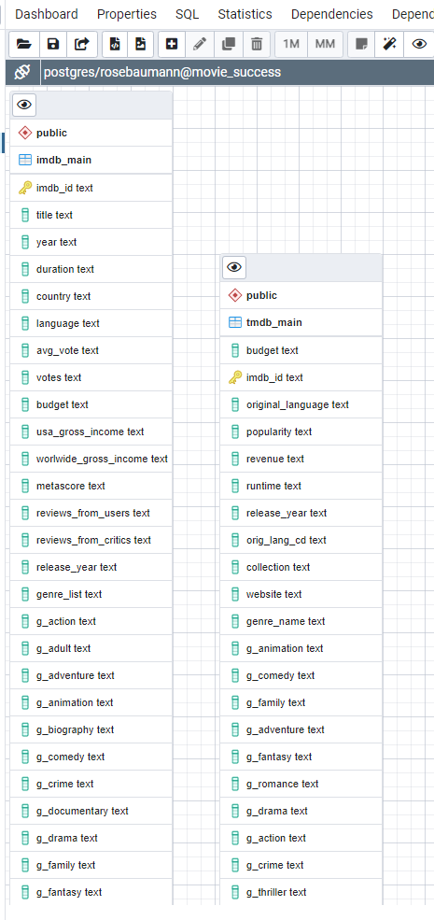
Our ERD

Slide 44
Data Sources
1 - source: IMDb Movies Extensive Dataset
https://www.kaggle.com/stefanoleone992/imdb-extensive-dataset
file: https://www.kaggle.com/stefanoleone992/imdb-extensive-dataset/download
Contains metadata scraped from IMDB movies with at least 100 votes as of 1/1/2020
2 - The Movies Dataset (TMDB)
source: https://www.kaggle.com/rounakbanik/the-movies-dataset?select=movies_metadata.csv
file: https://www.kaggle.com/rounakbanik/the-movies-dataset/download
Contains metadata from the Full MovieLens Dataset for movies released on or before July 2017.
3 - Film Awards (IMDB)
source: https://www.kaggle.com/iwooloowi/film-awards-imdb
Last updated 3/25/2020

Slide 45
Link to Repository
Link to ReadMe.md file
Link to Profile Report

